Slide 1
Big Mountain Resort
Runqi Wang

Slide 2
Problem identification
Big Mountain Resort, a ski resort located in Montana, offers spectacular views of Glacier National Park and Flathead National Forest, with access to 105 trails. Every year about 350000 people ski or snowboard at Big Mountain.
Recently, Big Mountain Resort installed an additional chair lift to help increase the distribution of visitors across the mountain, which caused their operating costs to increase by $1540000 this season. Their ticket price is based on the average market price, which does not show the value of some important facilities more than others.
So they need to change their price strategy to maximize their benefits, or some other changes to cus costs without undermining the ticket price.

Slide 3
Recommendation and key findings
After detailed analysis of the data provided I can conclude that Big Mountain Resort as one of the ski resorts in the Northern United States can follow the guides described below to be able to keep the profit margin as it currently is.
To keep the margin at this level there are different approaches which could be used. The validity of our model lies in the assumption that other resorts accurately set their prices according to what the market (the ticket-buying public) supports. The fact that our resort seems to be charging that much less that what's predicted suggests our resort might be undercharging. But if ours is mispricing itself, are others? It's reasonable to expect that some resorts will be "overpriced" and some "underpriced."

Slide 4
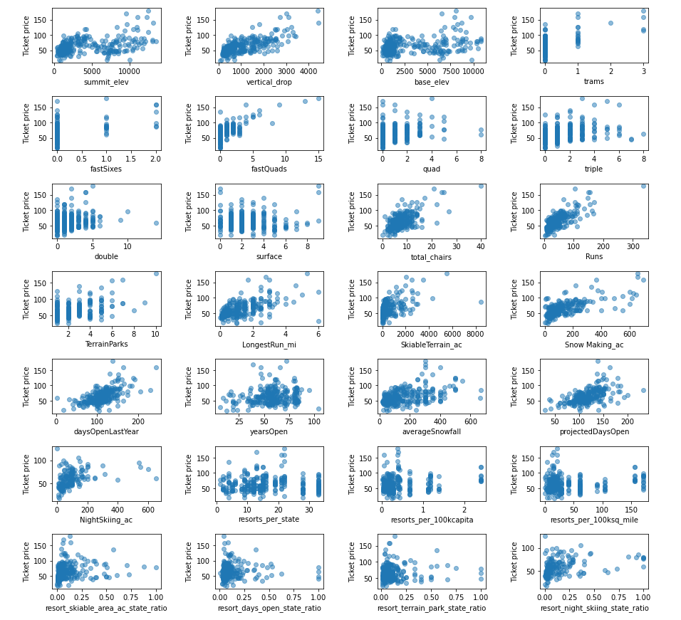
Modeling results and analysis
As we explored the datasets, we find the the relationship between different features and ticket price, which is showed left.
We can see that vertical_drop, fastQuads, Runs and total_chairs have strong relationship with ticket price. So we can use those four columns to predict the price with max profits.

Slide 5
Modeling results and analysis
As we test on different model, we find the random forest model has the lowest mean absolute error. So we make the final prediction with random forest model.

Slide 6
Modeling results and analysis
After applied random forest model on our datasets, we find modelled price is $95.87 with error of $10.39. With that price range, we could build more scenarios.

Slide 7
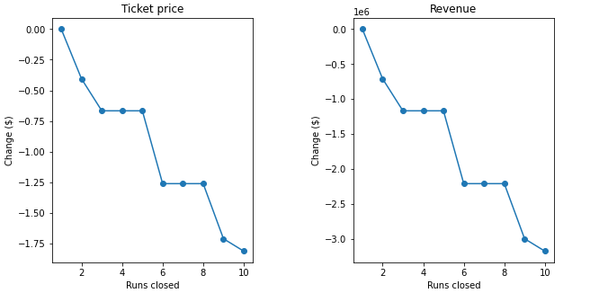
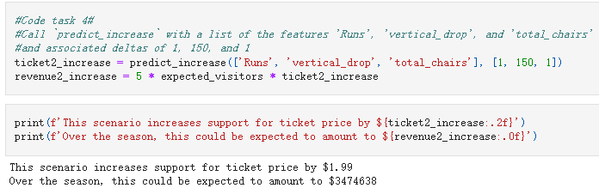
Modeling results and analysis
Scenario 1
Close up to 10 of the least used runs. The number of runs is the only parameter varying.
As closing more runs, the ticket pierce and revenue drops. So this scenario is bad!!!
Scenario 2
In this scenario, Big Mountain is adding a run, increasing the vertical drop by 150 feet, and installing an additional chair lift.
So this scenario can increase ticket price by $1.99 and increase revenue by $3474638.

Slide 8
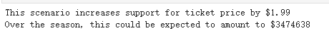
Modeling results and analysis
Scenario 3
In this scenario, you are repeating the previous one but adding 2 acres of snow making.
Compared with scenario 2, this scenario makes no difference. This is also a bad scenario!!!
Scenario 4
This scenario calls for increasing the longest run by .2 miles and guaranteeing its snow coverage by adding 4 acres of snow making capability.
We find this scenario makes 0 increase. So this scenario is bad!!!

Slide 9
Summary and conclusion
Although the longest run feature was used in the linear model, the random forest model (the one we chose because of its better performance) only has longest run way down in the feature importance list. The suggested ticket price is $95.87. And the support for ticket price will increase by $1.99 and over the season, this could be expected to amount to $3,474,638. So that the profit margin can be maintained or even increased.

